Slide 1
Magic the Gathering Card Scanner
Klayton, Radeeb, Sam, TJ, and Zach

Slide 2
Goals
Write a program that identifies a card from Magic: The Gathering based on a picture of it
Not particularly concerned with front-end usability
Envisioned as a back-end, cloud-hosted component of a mobile app
Could be tied into external databases/APIs to fetch useful data
Pricing information
Rules clarification

Slide 3
Plans
Initially we considered using external libraries
Processing’s version of OpenCV
Ultimately decided to write it all in Processing ourselves.

Slide 4
What is Magic: the Gathering?
Magic is a trading card game
Originally published in 1993
One of the most popular trading card games in the world
Over 10,000 unique cards exist!

Slide 5
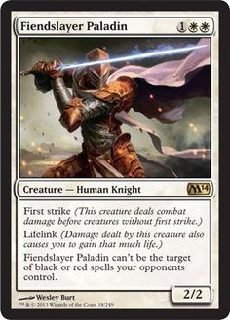
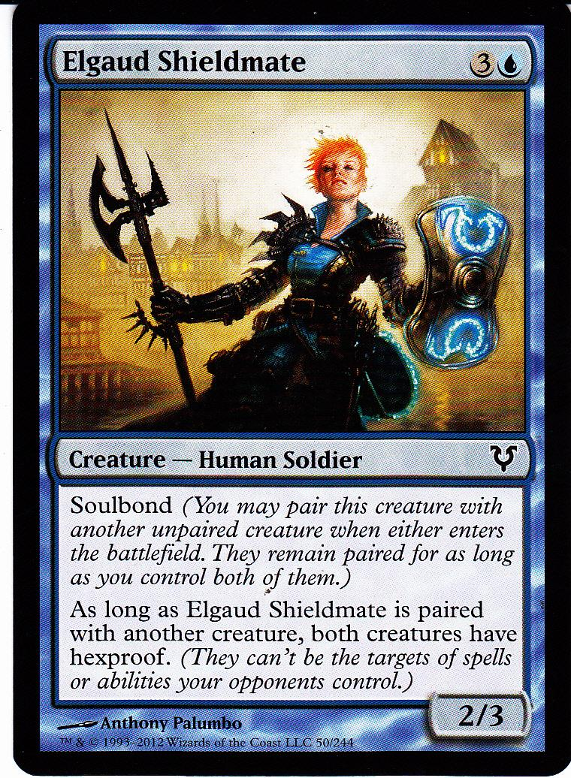
Magic the Gathering Cards

Slide 6
Name of the card

Slide 7
Cost of the Card

Slide 8
Type of the Card

Slide 9
Set and Rarity of the Card

Slide 10
Description for the Card

Slide 11
Power and Toughness of the Card

Slide 12
Image for the Card

Slide 13
Demo

Slide 14
Questions

